Slide 1
GCIG Material Transfer and Service Agreement designed to go across borders and across tumor types specifically with rare tumours in mind, to go to IRCI next…
Nathalie Le Fur
Anastassia Negrouk
Jose Antonio López
Iain Mcneish
Carmela Monger
Clare Scott

Slide 2
Aim: to streamline pre-clinical research to ensure that samples collected for one study with expensive clinical annotation can be used for additional research studies
AND that a researcher collecting a rare tumor type requiring multiple MTAs can use a globally “endorsed” MTA to take to each institution including their own!!!

Slide 3
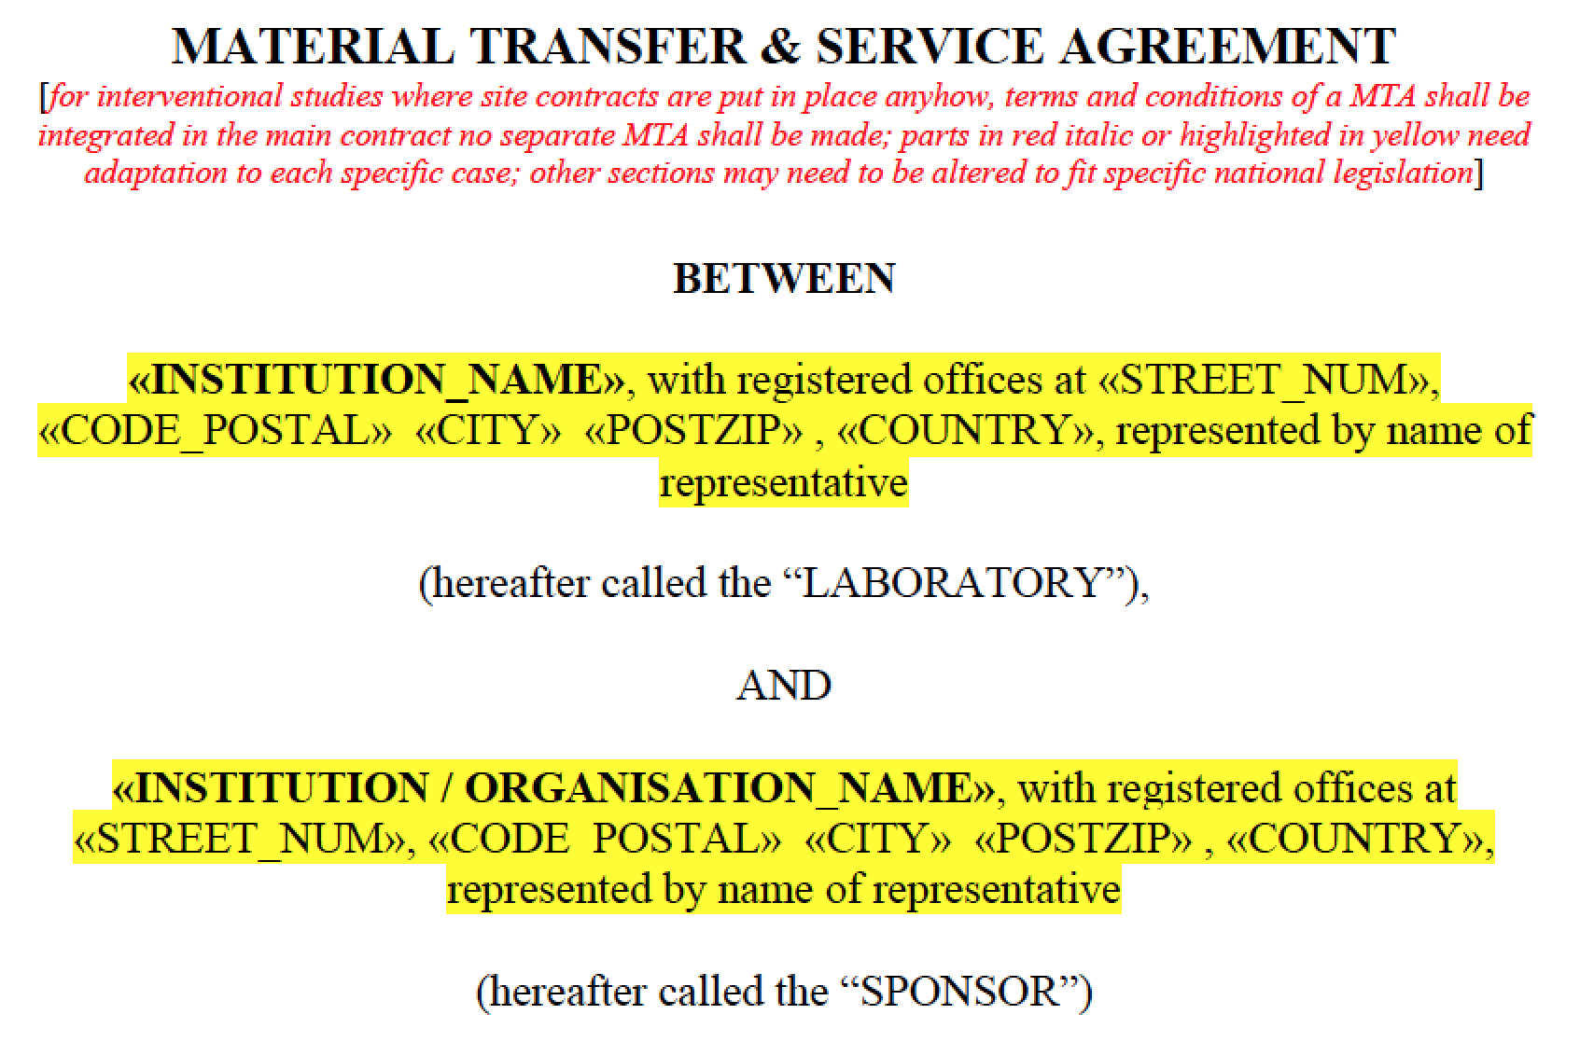
MTSA version 1.0 May 2015
Agreement between SPONSOR and LABORATORY for material handling (analyses, archiving)

Slide 4
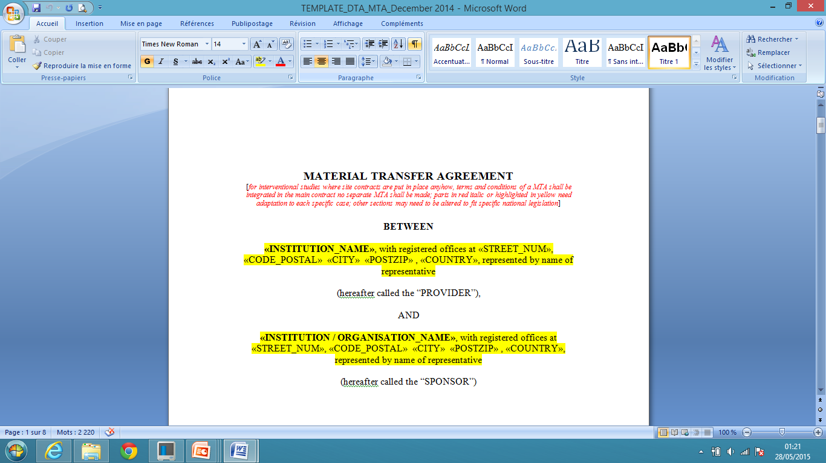
MTA version 1.0 Dec 2014
Agreement for material transfer from PROVIDER (Site) to SPONSOR

Slide 5
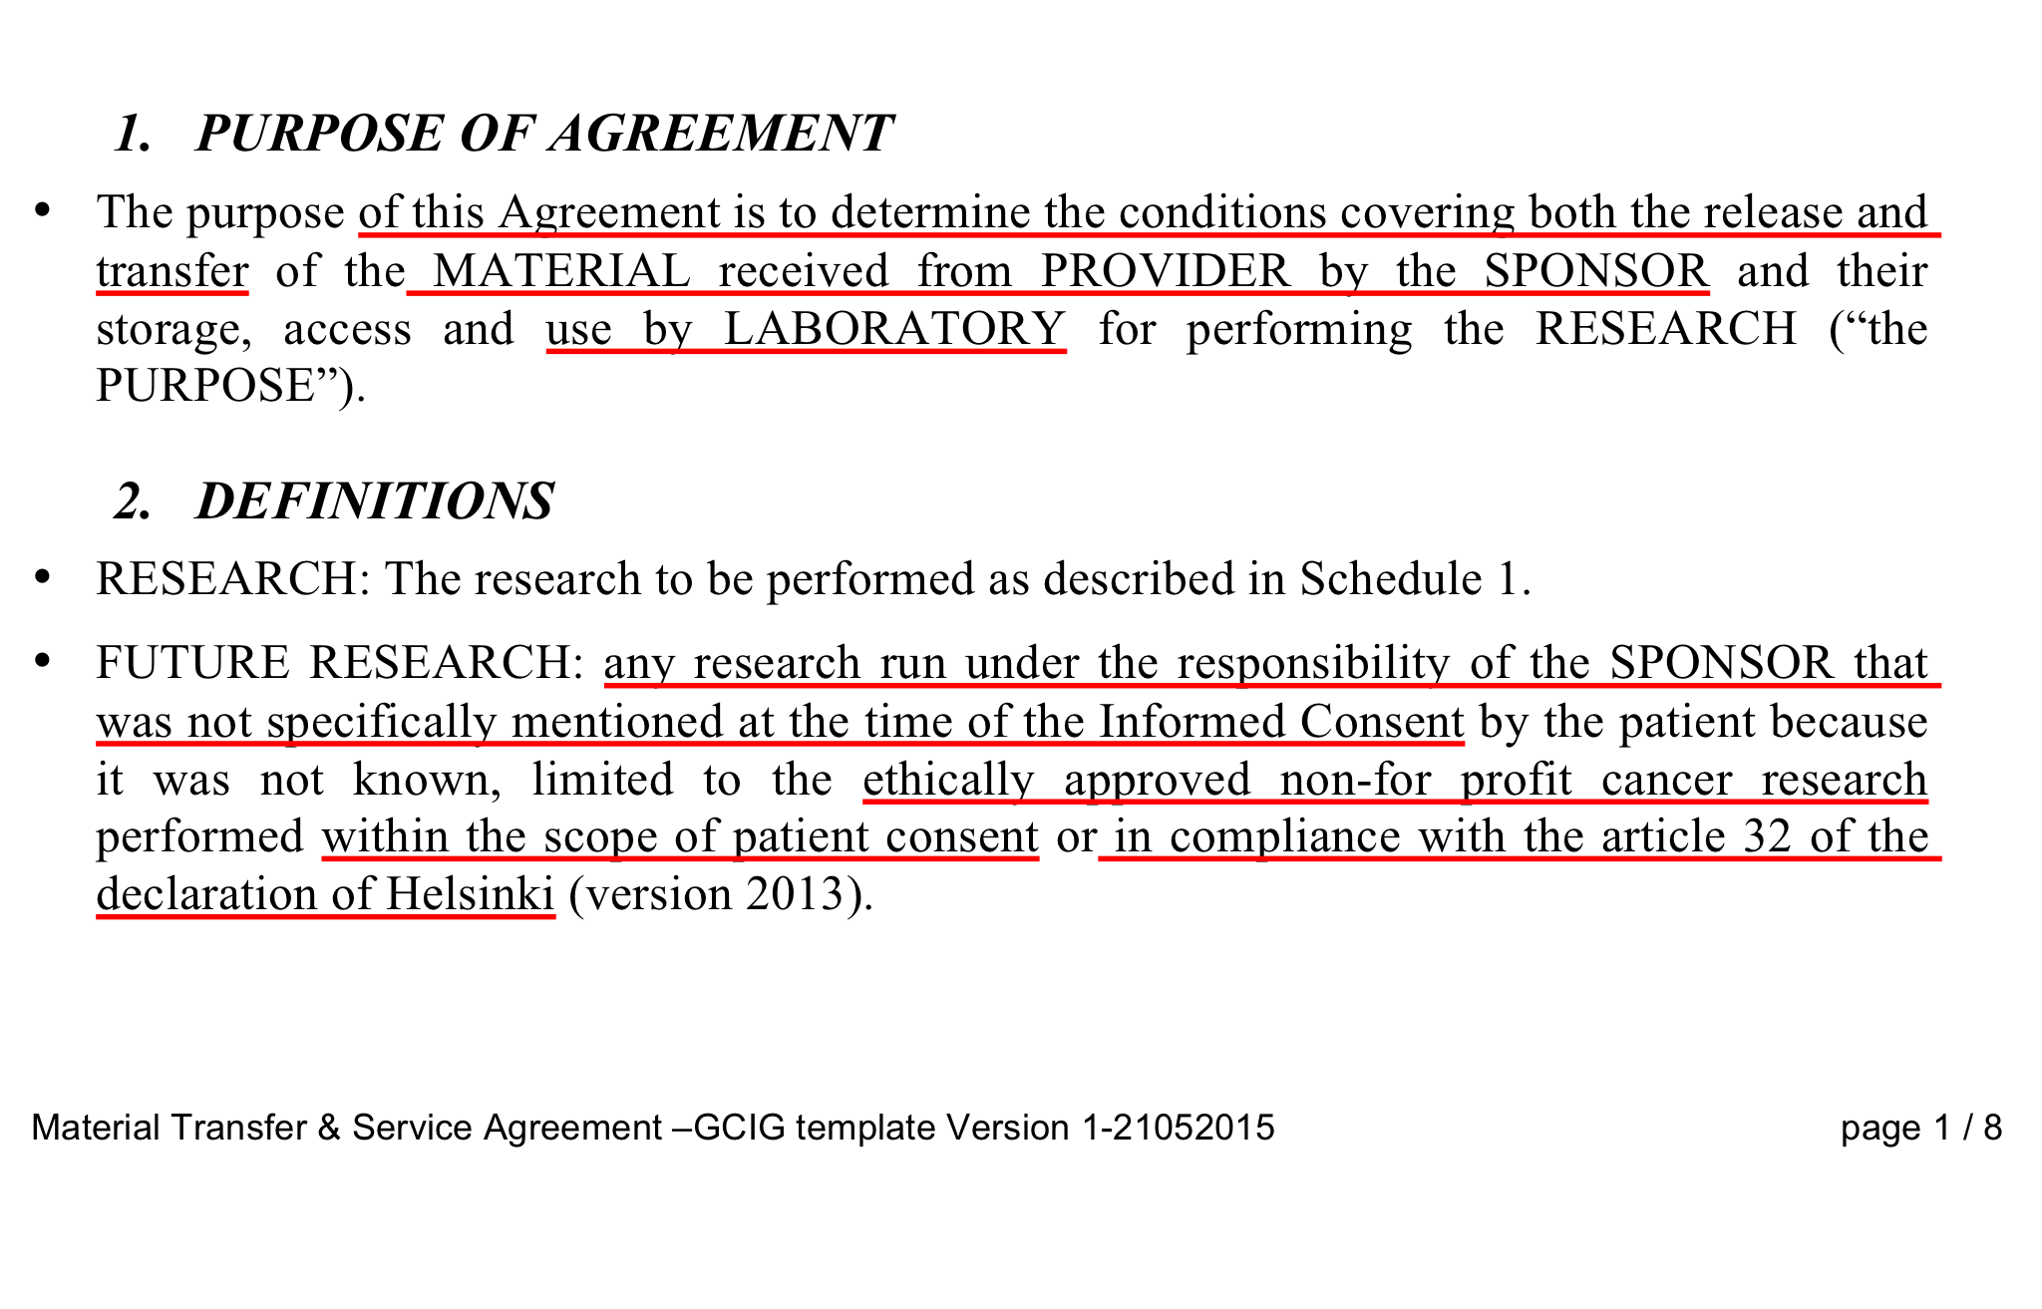
Agreement adresses question of RESEARCH and FUTURE RESEARCH

Slide 6
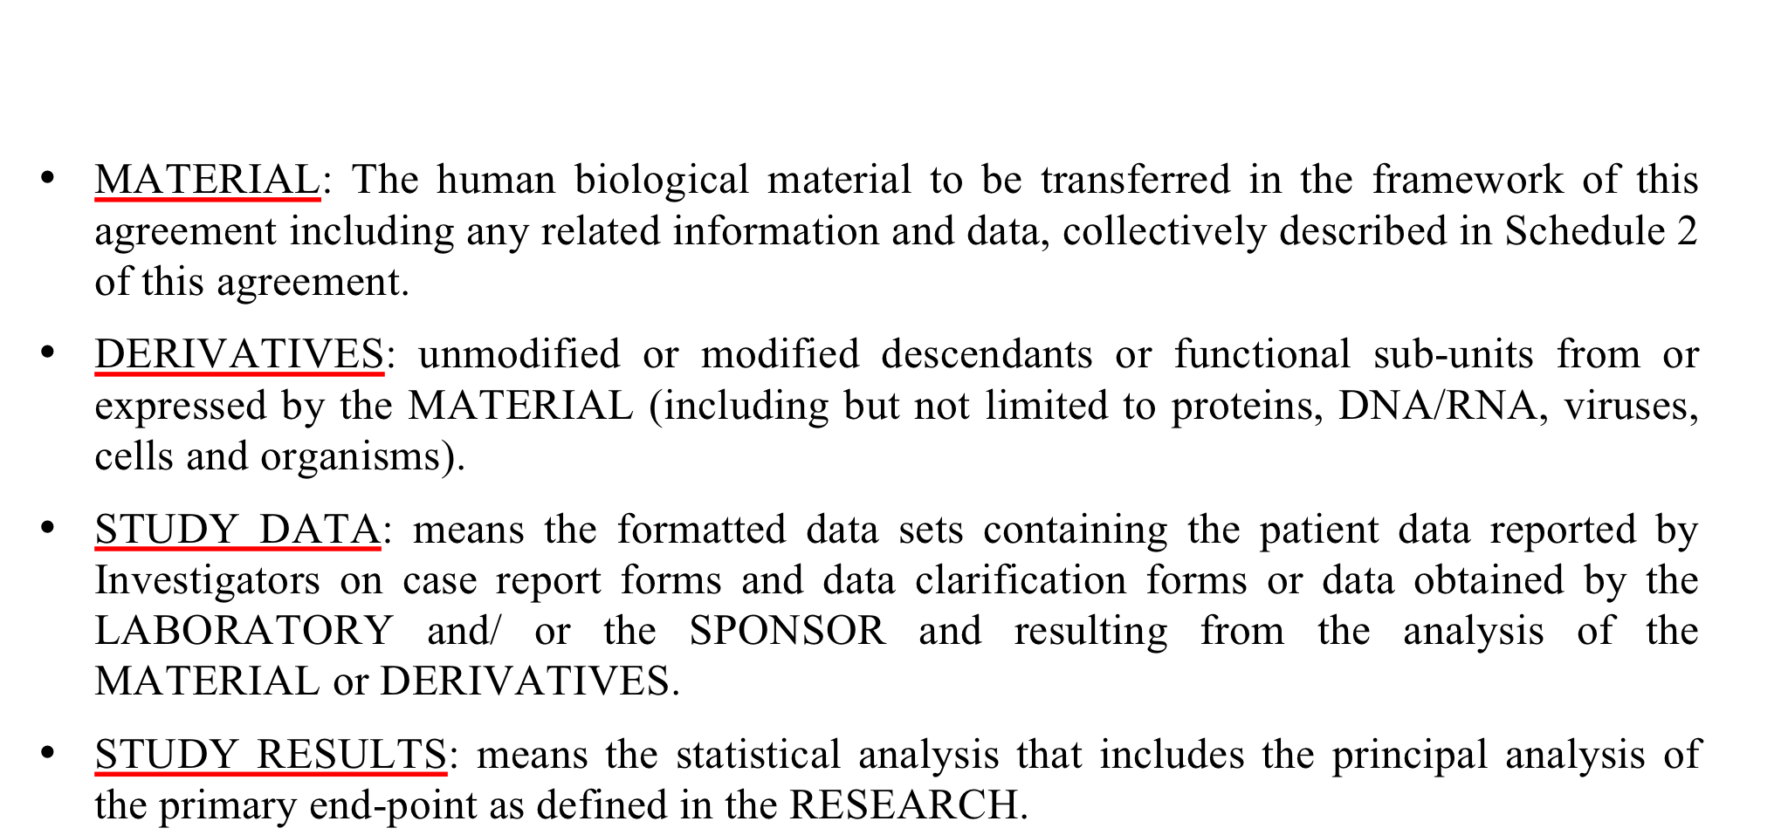
Agreement includes derivatives

Slide 7
Terms and Definitions
PROVIDER: The organization providing the MATERIAL (Organization which detains the MATERIAL, usually the SITE or PATHOLOGIST LAB)
SPONSOR: the person, individual or group that takes responsibility for the initiation, management and financing of the research.
CUSTODIAN: legal entity responsible for safeguarding MATERIAL and oversight of its use. Formal responsibility for custodianship rests with organizations rather than individual persons.
  CUSTODIAN can be PROVIDER / SPONSOR / OTHER
  It is not appropriate to speak about ownership in relation to material or derivatives; therefore the term of ownership shall not be used]
COORDINATOR OF THE CHAIN OF CUSTODY: the entity responsible for ensuring all organizations participating in chain of custody act in compliance with the project, applicable legislation and existing contractual agreements (usually the SPONSOR)

Slide 8
MTA version 1.0 Dec 2014
Purpose of this Agreement
To determine the conditions covering both the release and transfer of the MATERIAL by PROVIDER to SPONSOR and their storage, access and use by SPONSOR for performing the RESEARCH
Sponsor responsibilities
Use of the material and derivatives (regulatory authorizations, financial compensation, use of material only for the RESEARCH or FUTURE RESEARCH (after all necessary approvals and written notice to the PROVIDER)
Provider rights
To request material return, publication

Slide 9
MTSA version 1.0 May 2015
Purpose of this Agreement
To determine the conditions covering both the release and transfer of the MATERIAL received from PROVIDER by the SPONSOR and their storage, access and use by LABORATORY for performing the RESEARCH
Laboratory responsibilities
Use of the material and derivatives in accordance to applicable laws, with high quality standard, according to instruction given by the sponsor
Material and derivatives shall not be sold nor use for other purpose than RESEARCH or FUTURE RESEARCH.
Sponsor responsibilities
To define publication policy, financial compensation
Sponsor is the owner of Study RESULTS from RESEARCH or FUTURE RESEARCH (with/without Provider)

Slide 10
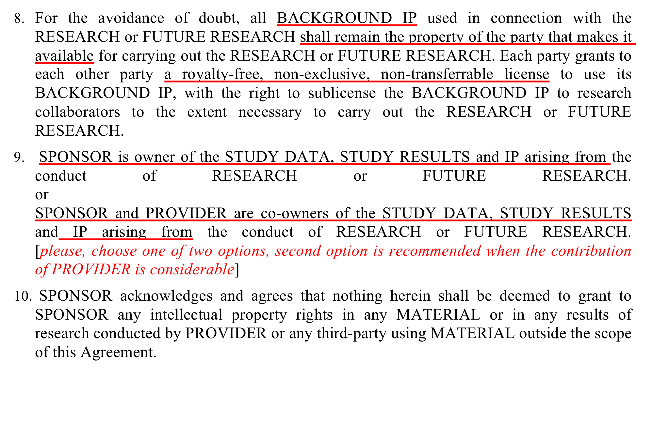
IP doesn’t actually change hands

Slide 11
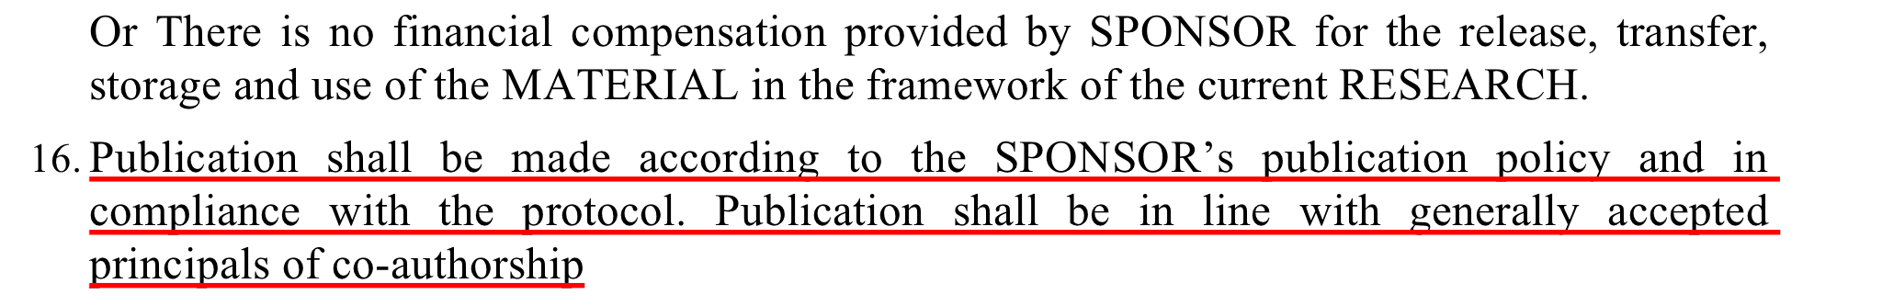
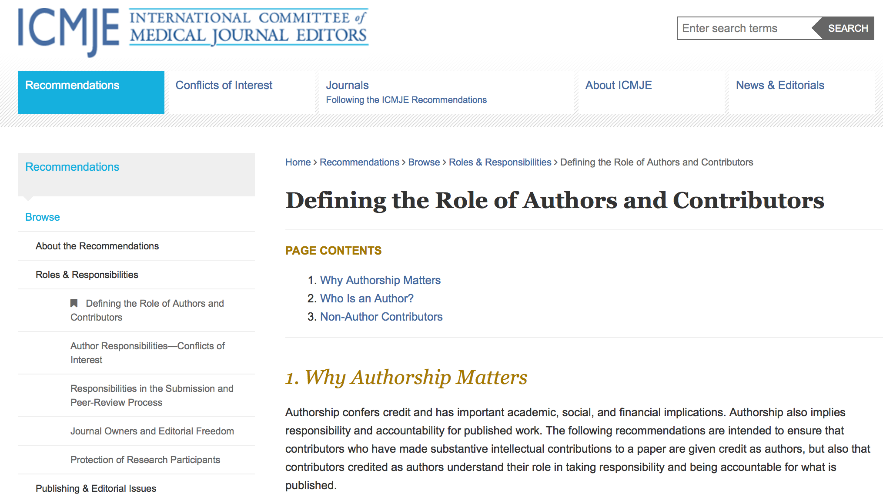
Publication according to GCIG guidelines
Contribution, not just supplying material

Slide 12

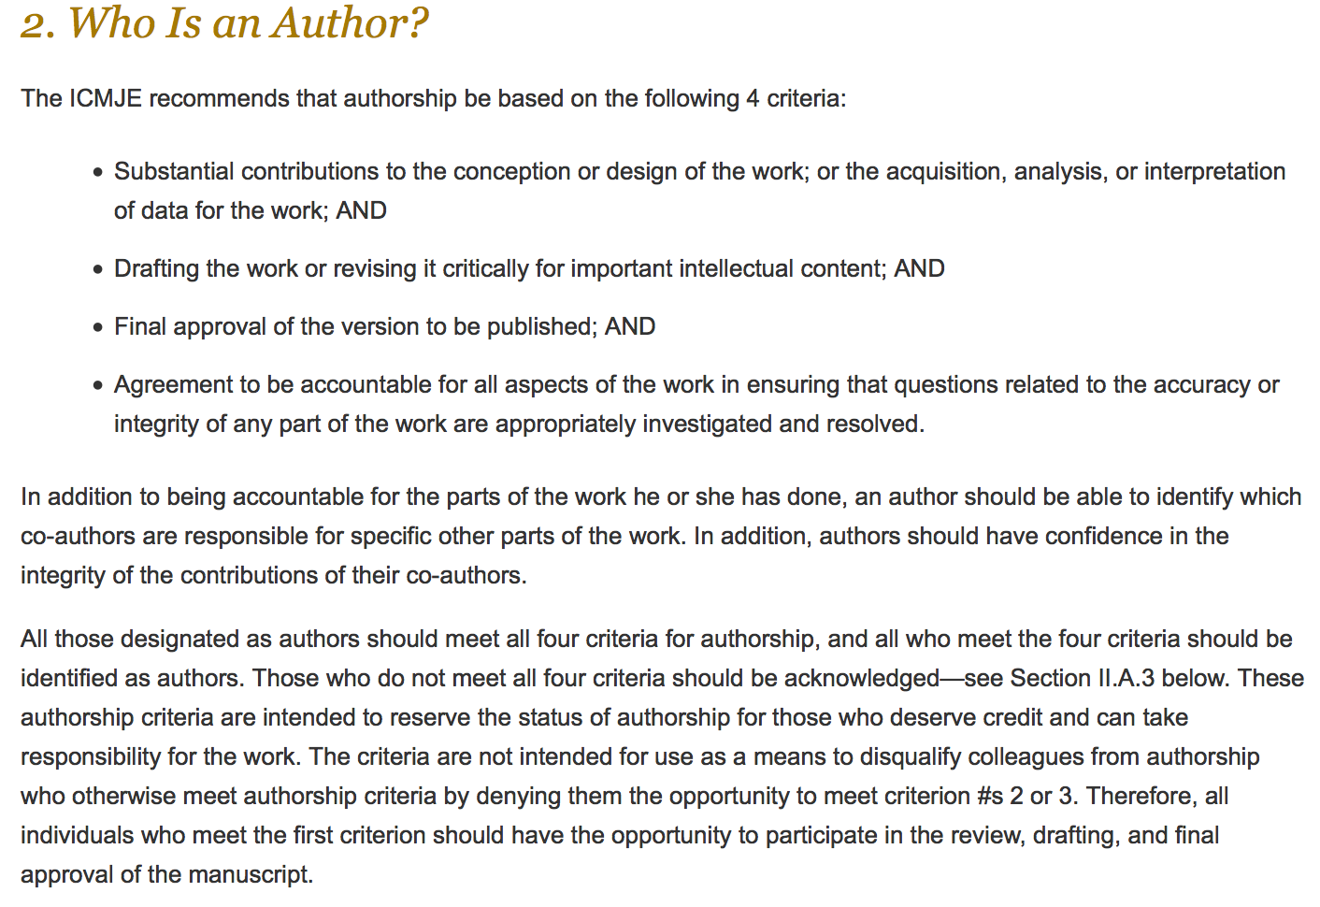

Slide 13
In summary
PATIENT
MATERIAL
Site
PROVIDER
Custodian of MATERIAL
Purpose of this Agreement
To determine the conditions covering both the release and transfer of the MATERIAL by PROVIDER to SPONSOR and their storage, access and use by SPONSOR for performing the RESEARCH
MTA
Transfer Agreement
Laboratory
Material Handling (analysing, storage)
Sponsor
Coordinator of chain of custody
MTSA
Transfer and Services Agreement
To determine the conditions covering both the release and transfer of the MATERIAL received from PROVIDER by the SPONSOR and their storage, access and use by LABORATORY for performing the RESEARCH

Slide 14
Future Directions
GCIG publication guidelines for TR
Validated laboratory to define

